Slide 1
Valero Welcome Permit Draft Review
Discussion deck focused on unrequested or unexplained draft changes
Overall outcome: Significant changes
Comparison rows
Highlight items
High-risk rows
High-confidence rows
28
12
9
25
Primary themes
Modeling framework shifts from PM10 trigger language to boundary-control and public-access obligations.
New ambient-boundary inspection, patrol, and breach-reporting requirements create recurring compliance tasks.
Draft permit introduces multiple changes not clearly identified in the major amendment application narrative.
Manual QA confirmed workflow false positives such as COMG 2, so this deck follows consultant-validated rows rather than raw workflow summary tabs.

Slide 2
Executive Summary
Counts by change type
Slides included in this deck
Revision: 14
Addition: 7
Deletion: 3
Possible relocation or renumbering: 4
Permit-wide and modeling changes replacing the existing PM10 framework
Ambient boundary, fencing, breach-reporting, patrol, and camera obligations
Unrequested STRU 11 language changes, including throughput and AOS applicability issues
CAM and testing revisions not clearly requested in the application package
Evidence confidence
High confidence: 25
Medium confidence: 3
Top subject areas
Performance Testing: 4
CAM: 4
Modeling: 3
Administrative: 2
Use this deck for discussion. Use the spreadsheet for full analysis and line-item support.

Slide 3
Significant Change Index
ID
Subject
Core change
Risk
Follow-up
PC-013
Emission Limits
The numerical PM, PM10, PM2.5, and opacity limits are carried forward, but the draft now states these...
High
Consider comment on draft and ask the...
PC-006
Ambient Conditions
The draft adds a General Public Preclusion Plan framework built around an effective fence line and a...
High
Confirm with agency that Appendix C...
PC-005
Modeling
The issued permit includes a full PM10 EBD and refined-modeling framework: submittal content,...
High
Flag for client discussion and confirm...
PC-028
Modeling
Beyond the PM10 provisions, the issued permit also contains a separate NOx and PM2.5...
High
Flag for client discussion and confirm...
PC-007
Reporting
The draft creates a new requirement to document ambient-boundary breaches within three calendar days...
High
Check consistency with current site...
PC-015
Throughput or Production Limits
The STRU 11 short-term DDGS loadout limit drops from 199.8 tons per hour to 178.8 tons per hour, and...
High
Verify basis in application and check...
PC-023
CAM
The recirculating scrubber water CAM limit for AOS 1 rises from 125.0 gpm to 145.0 gpm based on the...
High
Check consistency with current...
PC-004
Modeling
The issued permit contains explicit PM10 equivalent-or-better-dispersion trigger language that...
Medium
Confirm with agency whether the EBD...
PC-026
Performance Testing
The periodic STRU 14 sulfur-dioxide testing requirement is materially simplified in the draft. The...
Medium
Confirm with agency whether the...
PC-009
Monitoring
The draft adds a formal security patrol plan with at least daily patrols for designated...
Medium
Check consistency with current...

Slide 4
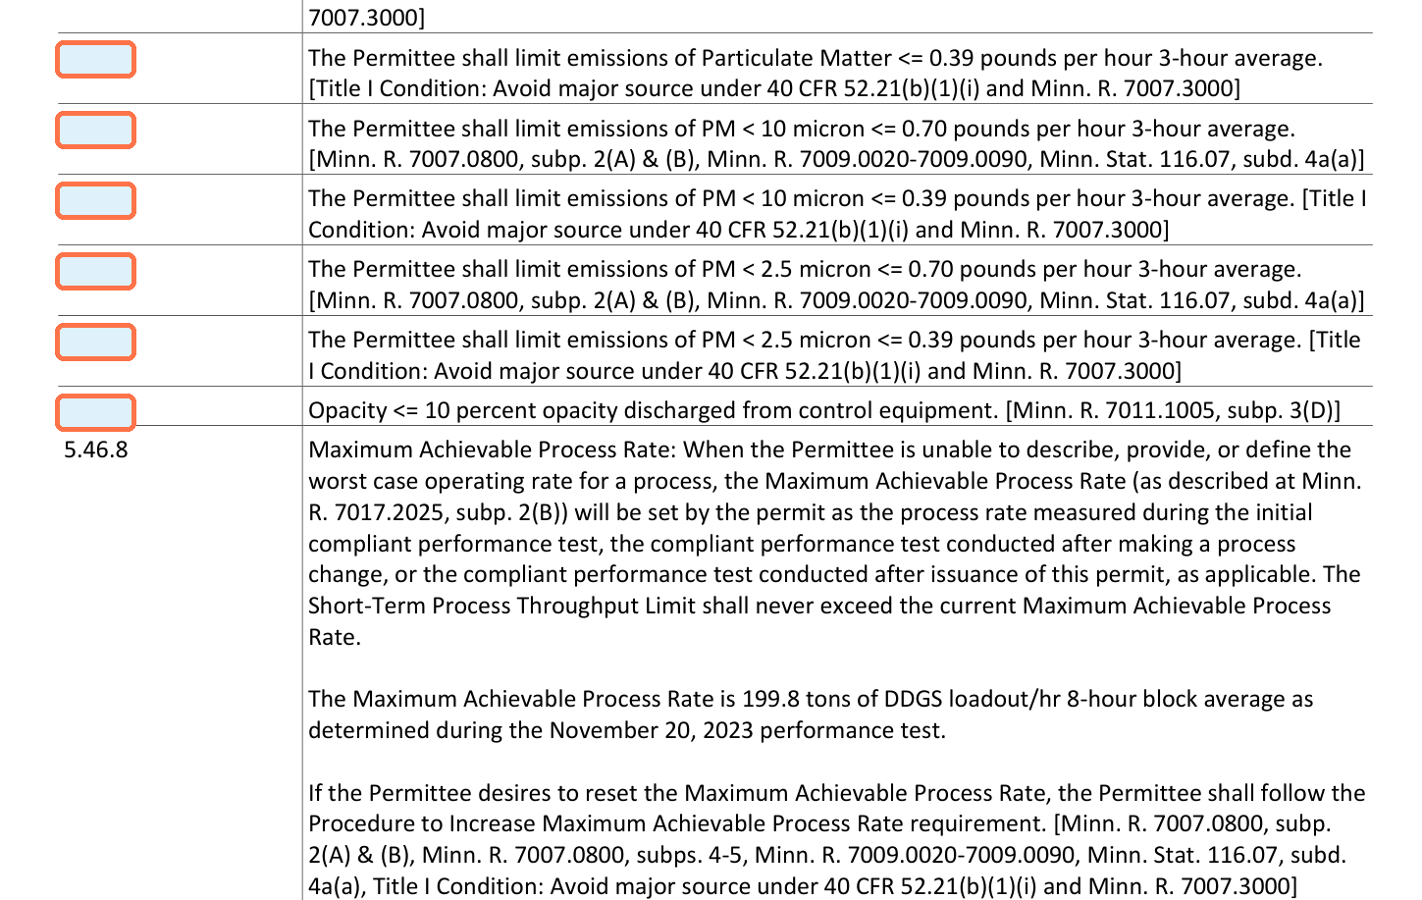
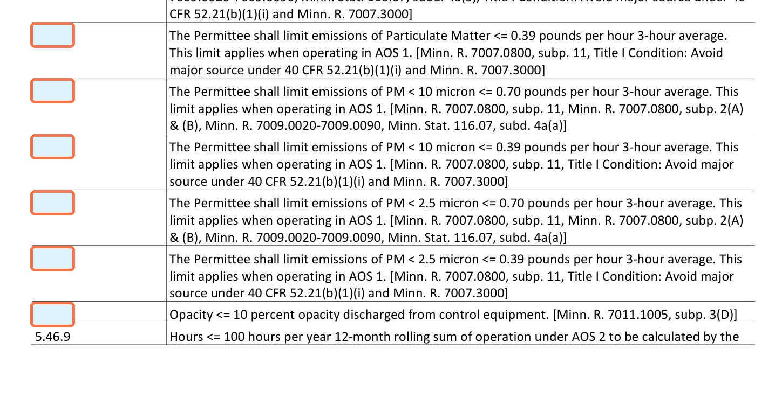
PC-013 | Emission Limits
Highlight
Old: 5.46.2-5.46.7 New: 5.46.3-5.46.8 Risk: High
Application basis: Not identified in application | Major Amendment DDGS BH Maintenance_2025.11.10.pdf; Valero Welcome Minor Amendment 7277_2025.02.27.pdf; Valero Welcome Air Permit Minor Mod - DDGS Drag Replacement.pdf; Valero Welcome Air Permit Minor Mod - TO Inspection.pdf
Evidence: High
Old permit | page 77
New permit | page 73
Change
Why it matters
Ask
The numerical PM, PM10, PM2.5, and opacity limits are carried forward, but the draft now states these limits...
The draft narrows the explicit applicability of existing emission-limit language and relies more heavily on...
Consider comment on draft and ask the agency to clarify what emission-limit framework...

Slide 5
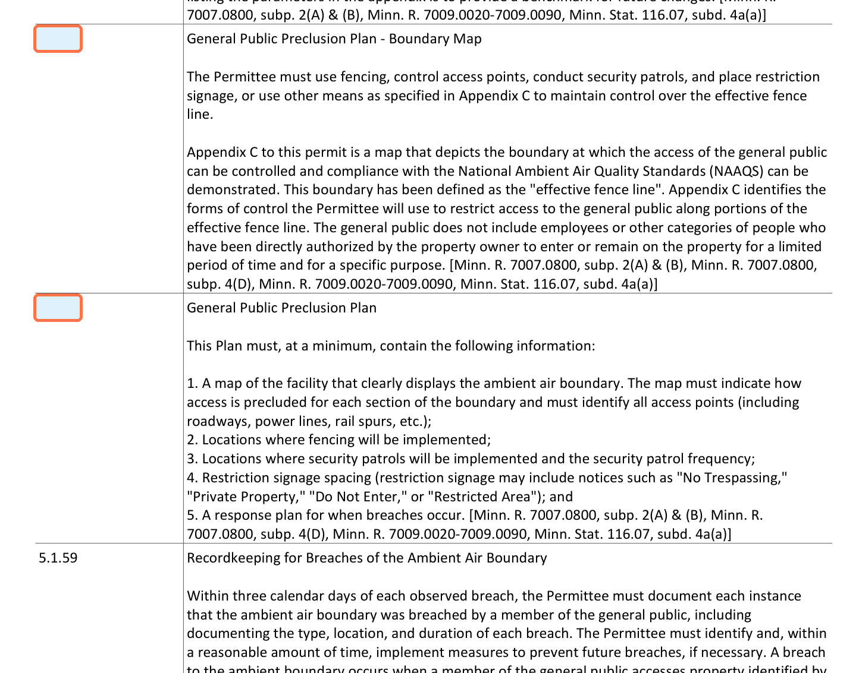
PC-006 | Ambient Conditions
Highlight
Old: No direct equivalent New: 5.1.57-5.1.58 Risk: High
Application basis: Not identified in application | Major Amendment DDGS BH Maintenance_2025.11.10.pdf; Valero Welcome Minor Amendment 7277_2025.02.27.pdf; Valero Welcome Air Permit Minor Mod - DDGS Drag Replacement.pdf; Valero Welcome Air Permit Minor Mod - TO Inspection.pdf
Evidence: High
Old permit
New permit | page 24
No corresponding condition in the issued permit.
Change
Why it matters
Ask
The draft adds a General Public Preclusion Plan framework built around an effective fence line and a...
These provisions affect how the source demonstrates non-ambient air and supports NAAQS compliance...
Confirm with agency that Appendix C and the plan requirements reflect existing site...

Slide 6
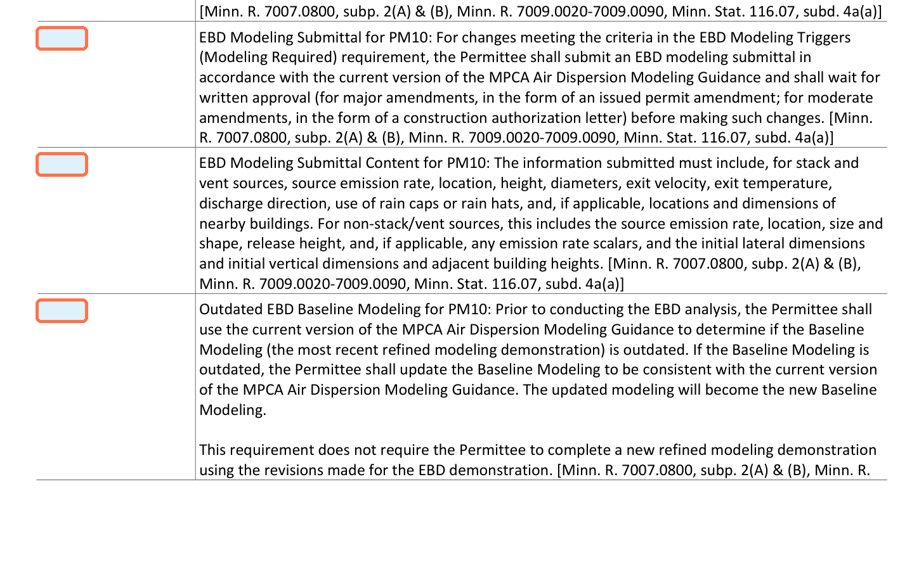
PC-005 | Modeling
Highlight
Old: 5.1.59-5.1.65 New: No direct equivalent Risk: High
Application basis: Not identified in application | Major Amendment DDGS BH Maintenance_2025.11.10.pdf; Valero Welcome Minor Amendment 7277_2025.02.27.pdf; Valero Welcome Air Permit Minor Mod - DDGS Drag Replacement.pdf; Valero Welcome Air Permit Minor Mod - TO Inspection.pdf
Evidence: High
Old permit | page 24
New permit
No corresponding condition in the draft permit.
Change
Why it matters
Ask
The issued permit includes a full PM10 EBD and refined-modeling framework: submittal content,...
This could reduce clarity on what must be submitted before making changes that affect modeled PM10...
Flag for client discussion and confirm whether the agency intends another enforceable...

Slide 7
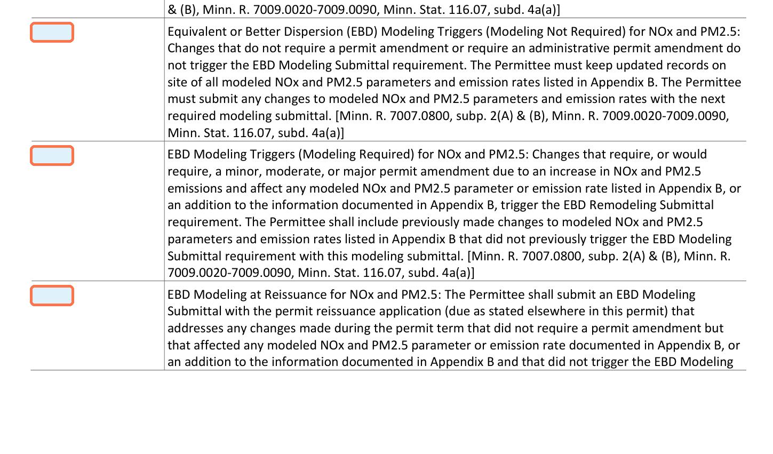
PC-028 | Modeling
Highlight
Old: 5.1.67-5.1.77 New: No direct equivalent Risk: High
Application basis: Not identified in application | Major Amendment DDGS BH Maintenance_2025.11.10.pdf; Valero Welcome Minor Amendment 7277_2025.02.27.pdf; Valero Welcome Air Permit Minor Mod - DDGS Drag Replacement.pdf; Valero Welcome Air Permit Minor Mod - TO Inspection.pdf
Evidence: High
Old permit | page 25
New permit
No corresponding condition in the draft permit.
Change
Why it matters
Ask
Beyond the PM10 provisions, the issued permit also contains a separate NOx and PM2.5...
Deleting the NOx/PM2.5 modeling framework further reduces the amount of explicit permit text governing when...
Flag for client discussion and confirm whether MPCA intentionally removed the NOx/PM2.5...

Slide 8
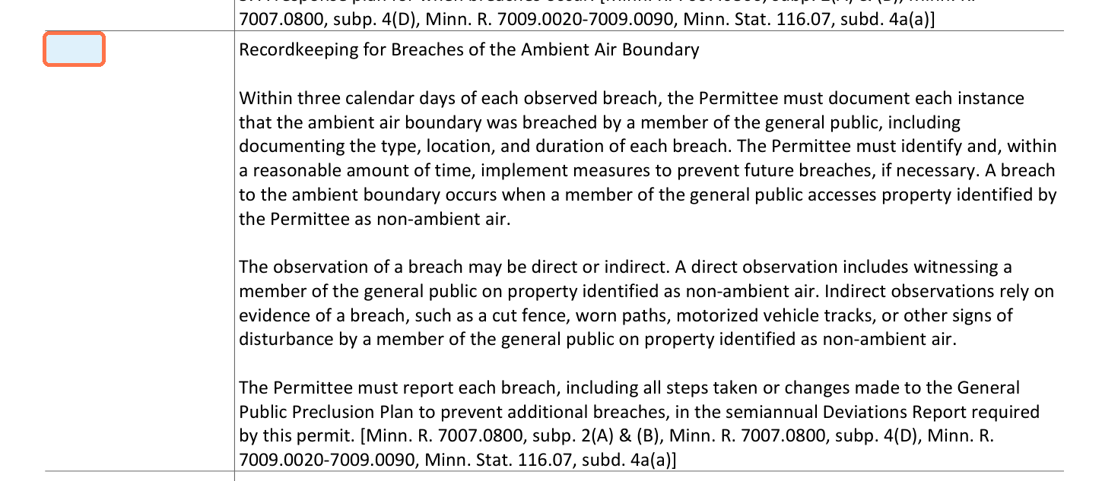
PC-007 | Reporting
Highlight
Old: No direct equivalent New: 5.1.59 Risk: High
Application basis: Not identified in application | Major Amendment DDGS BH Maintenance_2025.11.10.pdf; Valero Welcome Minor Amendment 7277_2025.02.27.pdf; Valero Welcome Air Permit Minor Mod - DDGS Drag Replacement.pdf; Valero Welcome Air Permit Minor Mod - TO Inspection.pdf
Evidence: High
Old permit
New permit | page 24
No corresponding condition in the issued permit.
Change
Why it matters
Ask
The draft creates a new requirement to document ambient-boundary breaches within three calendar days and...
This adds a new deviation-reporting pathway tied to non-ambient air boundary control rather than emissions...
Check consistency with current site security practices and flag for client discussion if...

Slide 9
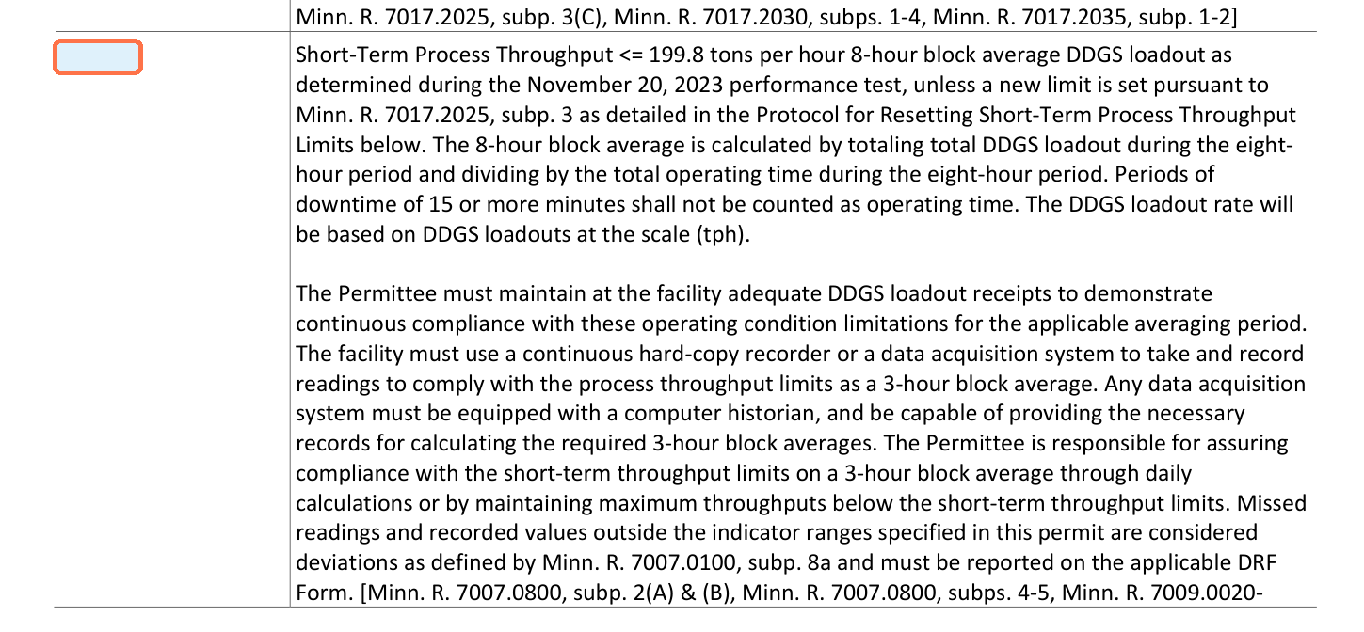
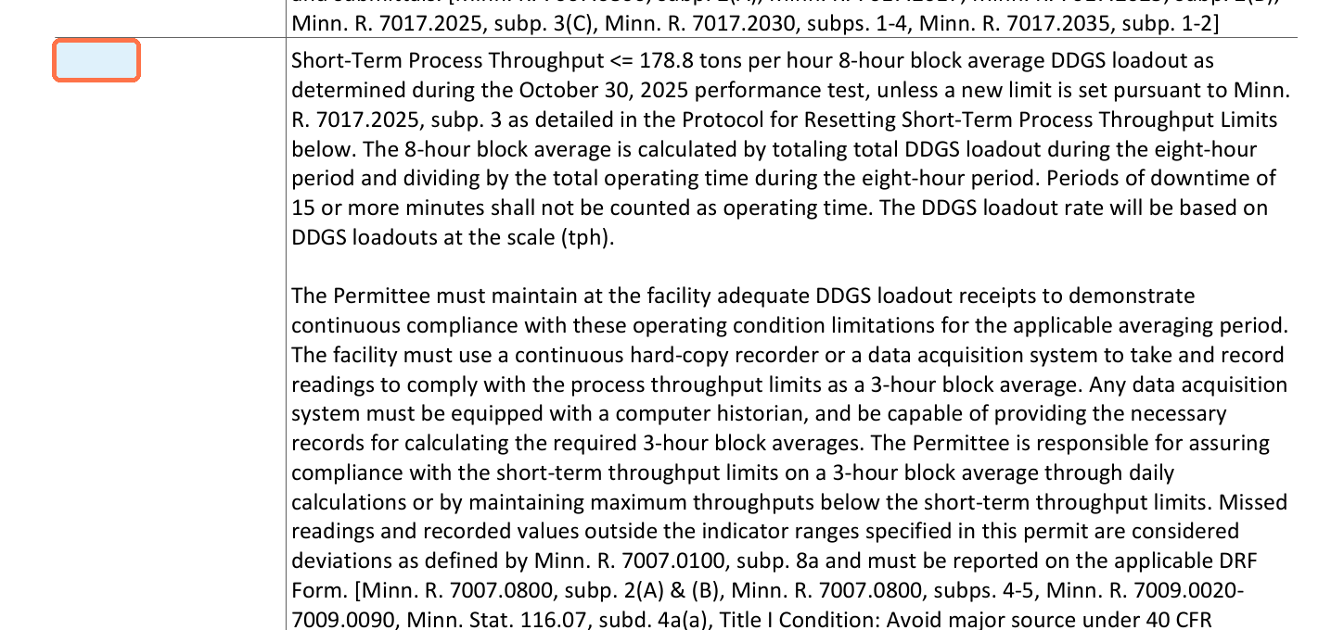
PC-015 | Throughput or Production Limits
Highlight
Old: 5.46.10 New: 5.46.14 Risk: High
Application basis: Not identified in application | Major Amendment DDGS BH Maintenance_2025.11.10.pdf; Valero Welcome Minor Amendment 7277_2025.02.27.pdf; Valero Welcome Air Permit Minor Mod - DDGS Drag Replacement.pdf
Evidence: High
Old permit | page 78
New permit | page 75
Change
Why it matters
Ask
The STRU 11 short-term DDGS loadout limit drops from 199.8 tons per hour to 178.8 tons per hour, and the...
The change reduces the permitted throughput benchmark that supports compliance demonstrations and future...
Verify basis in application and check consistency with current operations before...

Slide 10
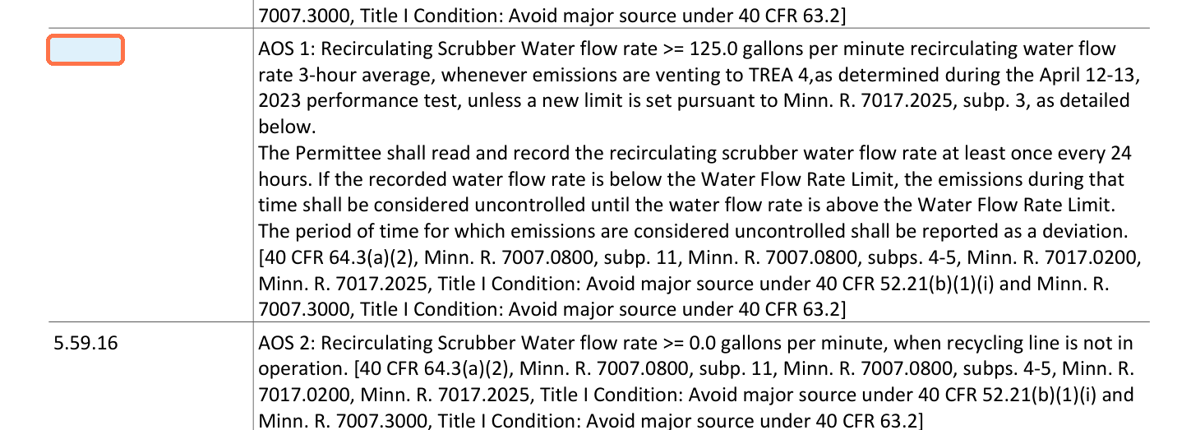
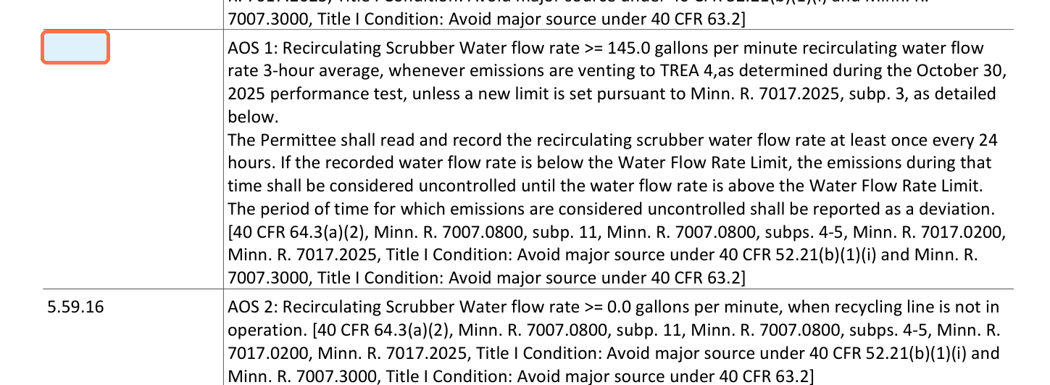
PC-023 | CAM
Highlight
Old: 5.59.15 New: 5.59.15 Risk: High
Application basis: Not identified in application | Major Amendment DDGS BH Maintenance_2025.11.10.pdf; Valero Welcome Minor Amendment 7277_2025.02.27.pdf; Valero Welcome Air Permit Minor Mod - DDGS Drag Replacement.pdf; Valero Welcome Air Permit Minor Mod - TO Inspection.pdf
Evidence: High
Old permit | page 117
New permit | page 113
Change
Why it matters
Ask
The recirculating scrubber water CAM limit for AOS 1 rises from 125.0 gpm to 145.0 gpm based on the October...
The higher CAM threshold increases the monitoring burden and tightens the margin for avoiding deviations....
Check consistency with current operations and confirm equipment can reliably sustain the...

Slide 11
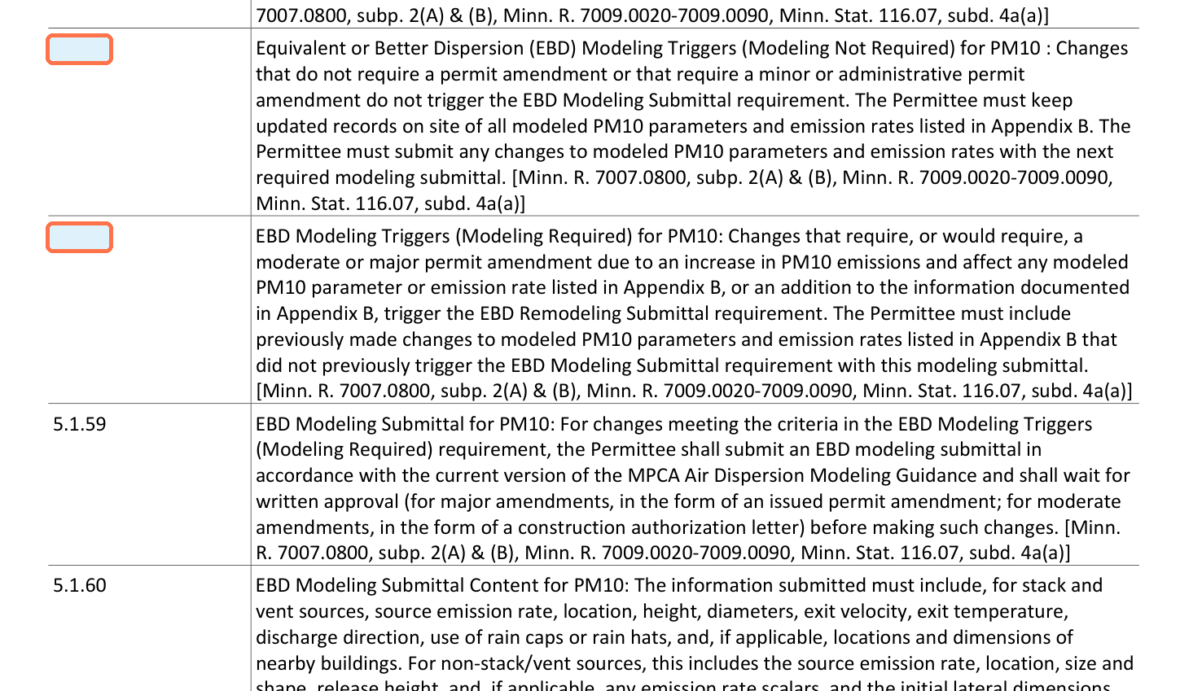
PC-004 | Modeling
Highlight
Old: 5.1.57-5.1.58 New: No direct equivalent Risk: Medium
Application basis: Not identified in application | Major Amendment DDGS BH Maintenance_2025.11.10.pdf; Valero Welcome Minor Amendment 7277_2025.02.27.pdf; Valero Welcome Air Permit Minor Mod - DDGS Drag Replacement.pdf; Valero Welcome Air Permit Minor Mod - TO Inspection.pdf
Evidence: High
Old permit | page 24
New permit
No corresponding condition in the draft permit.
Change
Why it matters
Ask
The issued permit contains explicit PM10 equivalent-or-better-dispersion trigger language that distinguishes...
Removing the explicit EBD trigger language can change how future modifications are evaluated for PM10...
Confirm with agency whether the EBD trigger concept is intentionally being retired or...

Slide 12
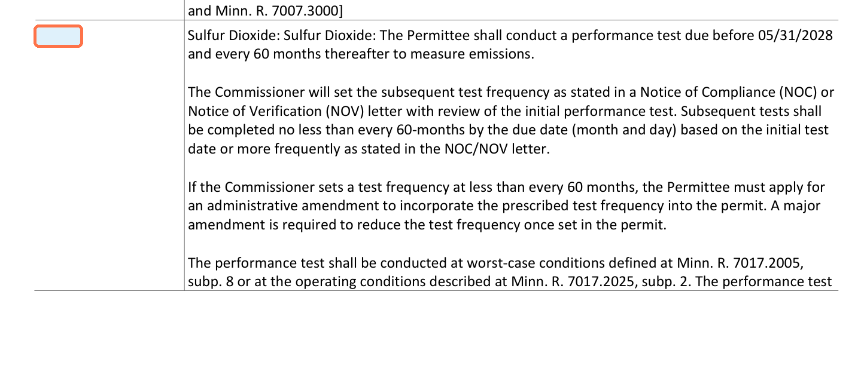
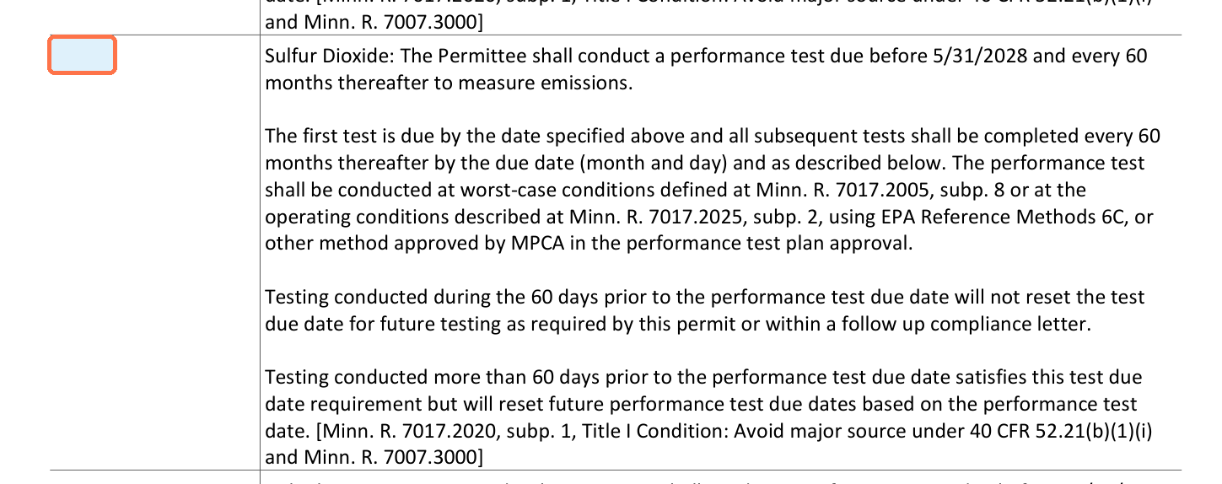
PC-026 | Performance Testing
Highlight
Old: 6.13.4 New: 6.13.4 Risk: Medium
Application basis: Not identified in application | Major Amendment DDGS BH Maintenance_2025.11.10.pdf; Valero Welcome Minor Amendment 7277_2025.02.27.pdf; Valero Welcome Air Permit Minor Mod - DDGS Drag Replacement.pdf; Valero Welcome Air Permit Minor Mod - TO Inspection.pdf
Evidence: High
Old permit | page 149
New permit | page 144
Change
Why it matters
Ask
The periodic STRU 14 sulfur-dioxide testing requirement is materially simplified in the draft. The issued...
This removes explicit permit language that could have increased periodic SO2 testing frequency and removes a...
Confirm with agency whether the deleted frequency-setting and sulfur-content language...

Slide 13
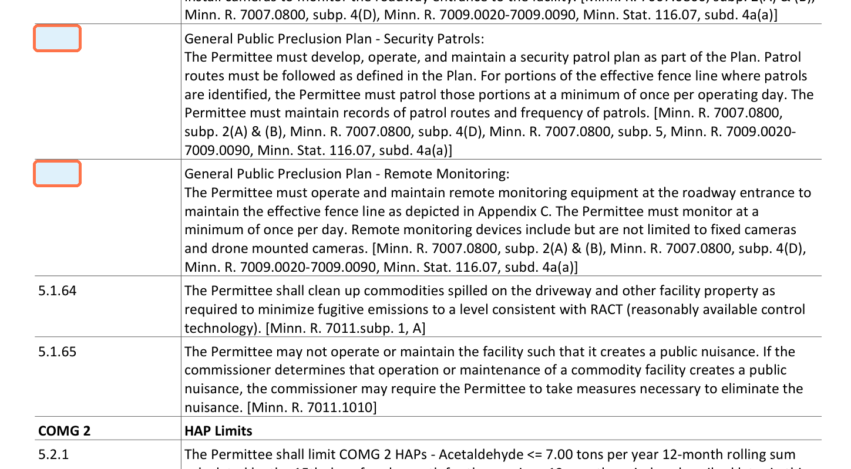
PC-009 | Monitoring
Highlight
Old: No direct equivalent New: 5.1.62-5.1.63 Risk: Medium
Application basis: Not identified in application | Major Amendment DDGS BH Maintenance_2025.11.10.pdf; Valero Welcome Minor Amendment 7277_2025.02.27.pdf; Valero Welcome Air Permit Minor Mod - DDGS Drag Replacement.pdf; Valero Welcome Air Permit Minor Mod - TO Inspection.pdf
Evidence: High
Old permit
New permit | page 25
No corresponding condition in the issued permit.
Change
Why it matters
Ask
The draft adds a formal security patrol plan with at least daily patrols for designated effective-fence-line...
These provisions increase the monitoring burden and create additional records that may be reviewed during...
Check consistency with current operations and confirm whether this reflects existing...

Slide 14
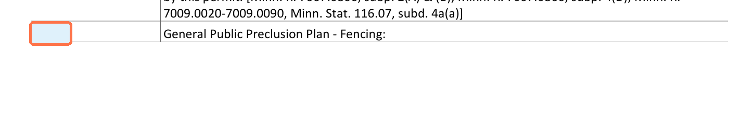
PC-008 | Monitoring
Highlight
Old: No direct equivalent New: 5.1.60-5.1.61 Risk: Medium
Application basis: Not identified in application | Major Amendment DDGS BH Maintenance_2025.11.10.pdf; Valero Welcome Minor Amendment 7277_2025.02.27.pdf; Valero Welcome Air Permit Minor Mod - DDGS Drag Replacement.pdf; Valero Welcome Air Permit Minor Mod - TO Inspection.pdf
Evidence: High
Old permit
New permit | page 24
No corresponding condition in the issued permit.
Change
Why it matters
Ask
The draft requires fencing along the effective fence line, quarterly fence inspections with maintenance...
The new terms expand enforceable monitoring and recordkeeping obligations tied to ambient-boundary control....
Confirm whether existing fencing and gate controls already satisfy the draft language or...

Slide 15
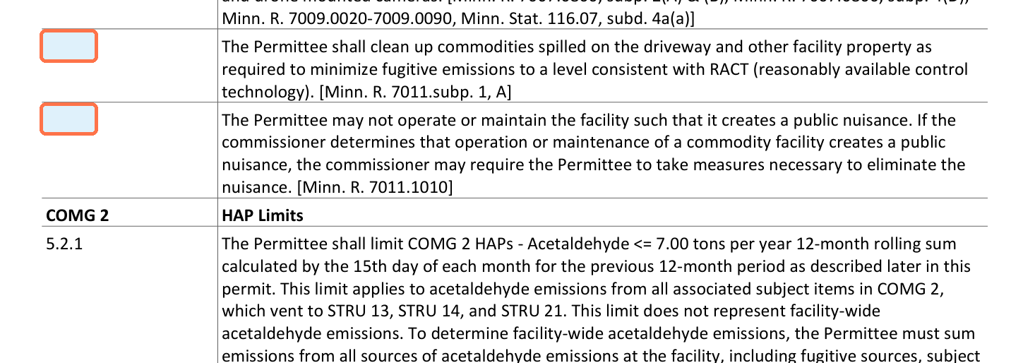
PC-010 | Fugitive Emissions
Highlight
Old: No direct equivalent New: 5.1.64-5.1.65 Risk: Medium
Application basis: Not identified in application | Major Amendment DDGS BH Maintenance_2025.11.10.pdf; Valero Welcome Minor Amendment 7277_2025.02.27.pdf; Valero Welcome Air Permit Minor Mod - DDGS Drag Replacement.pdf; Valero Welcome Air Permit Minor Mod - TO Inspection.pdf
Evidence: High
Old permit
New permit | page 25
No corresponding condition in the issued permit.
Change
Why it matters
Ask
The draft adds a requirement to clean up spilled commodities as needed to minimize fugitive emissions and...
The spill-cleanup term reinforces fugitive dust control expectations. The nuisance language could broaden...
Confirm with agency whether the nuisance language is standard for this permit form and...

Slide 16
Close-Out
Recommended client discussion points
Files in the package
Whether the STRU 11 direct-vent AOS 2 is operationally necessary and fully supported by the application and modeling basis.
Whether MPCA intends the deleted PM10 modeling trigger framework to be replaced by other enforceable documents or internal review practices.
Whether new boundary security, patrol, camera, and breach-reporting obligations match current site controls without added capital or staffing.
Whether revised throughput and CAM thresholds align with current operations and accepted October 30, 2025 test data.
permit_comparison_analysis.xlsx
permit_comparison_summary.md / .docx
permit_significant_changes_presentation.pptx
permit_review_interface.html for QAQC
Excerpt images are pulled from the mapped permit pages and flagged at the condition location when possible.

